Slide 1
IEM STUDENT AWARD 2021
Name:RAHUL RUDRA
Department: Computer Science And Engineering(CSE)
Class Roll:192
Year:4th year(2017-2021)

Slide 2
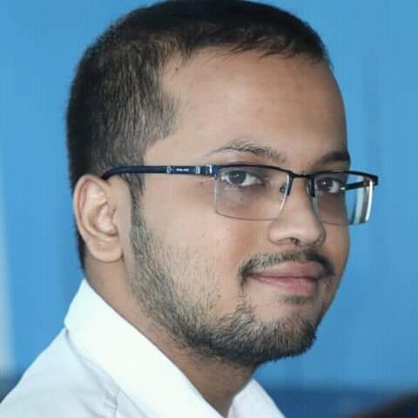
Introduction
I am Rahul Rudra

Slide 3
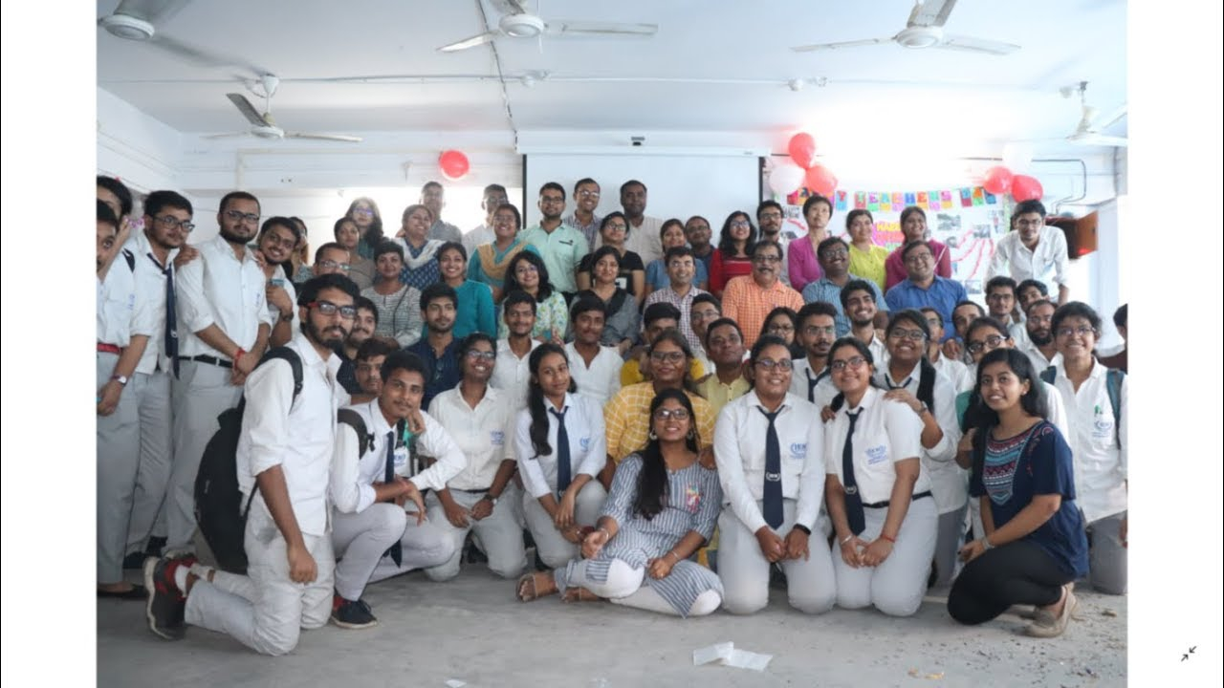
Roles
I along with my friends organized Teacher’s day on 2019 of CSE department

Slide 4
Achievements
I attended the offline class lectures of teachers(August 2017-March 2020)
I maintained 85%+ attendance when the classes were held offline
I was highest attendance getter in my department
I obeyed and followed my teacher’s advices during my 4 years of Iem journey
I was a punctual student and submitted teacher’s assignment within Due date
I organized the teacher’s day along with my friends on 2019

